Slide 1


Comprehensive Research Report on Participants in Financial Markets
Understanding the Financial Markets Ecosystem
PROJECT 1: FOUNDATION PROJECT
FINANCE TRAINING PROGRAM
Notes:
1

Slide 2

Why Do Financial Markets Matter?
Without Financial Markets
With Financial Markets
Direct connection between savers and entrepreneurs
Savers keep money in banks earning minimal returns
Efficient capital allocation to productive uses
Entrepreneurs struggle to find capital for growth
Risk distribution across many participants
Capital allocation becomes highly inefficient
Investment liquidity enables faster capital flow
Risk concentrates in limited places
Overall economic growth remains constrained
Accelerated economic growth and innovation
"Financial markets solve the fundamental problem of connecting those with capital to those who need it—creating the foundation for modern economic prosperity."
Notes:
2

Slide 3








The Financial Markets Ecosystem
Who Are the Key Players?
Investors
Companies
Retail individuals and institutional funds seeking wealth creation and returns through market participation.
Issuers raising capital through IPOs and bonds to fund growth, expansion, and operations.
Regulators
Intermediaries
SEBI and RBI protecting investors and ensuring market fairness and transparency.
Brokers, exchanges, and clearing corporations that execute trades and guarantee settlement.
The financial markets ecosystem also includes rating agencies, auditors, research houses, custodians, and depositories—each playing a critical role in maintaining market integrity and supporting efficient capital flows.
Notes:
3

Slide 4





Follow the Money: The Journey of ₹100
Understanding Transaction Flows and Costs
Investor's Bank Account
Investor initiates purchase of ₹100 worth of stock through trading platform.
Broker Processing
Receives order, verifies funds. Fee: ₹0.05 (0.05% brokerage)
Exchange Matching
Matches buyer with seller at market price. Fee: ₹0.01 (exchange listing)
Clearing Guarantee
Clearing corporation guarantees settlement. Fee: ₹0.005 (clearing)
Depository Settlement
Securities held electronically in demat account. Fee: ₹0.01 (depository)
₹0.075
98%
₹99.93
Total Intermediary Fees
Cost Reduction
Net Investment
Just 0.075% of transaction—dramatically lower than historical costs
Technology has reduced fees by 98% since the 1990s
Amount actively working in the market for the investor
Notes:
4

Slide 5


Who Actually Moves Markets?
Institutional Investors: The Real Market Movers
Retail Investors
Institutional Investors
Number: 15 million individual investors in India
Entities: 2,000+ mutual funds, insurance, pension funds
Average portfolio: ₹5-50 Lakh per investor
Combined AUM: ₹45+ Lakh Crore under management
Market impact: Low individual influence
Market impact: High—drives price movements
Trading pattern: Buy and hold strategy
Trading pattern: Active daily/weekly allocation
Time horizon: 5-20+ years for wealth building
Time horizon: 3-7 years with tactical adjustments
70%
30%
Market volume controlled by institutional investors
Market volume from retail investor trading
Mutual Funds
Insurance Companies
AUM: ₹45 Lakh Cr | Returns: 12% avg | Fee: 1% annually
Assets: ₹35 Lakh Cr | Strategy: 50% bonds, 30% stocks for stability
Pension Funds (NPS)
Sovereign Wealth Funds
AUM: ₹8 Lakh Cr | 2.5 Crore subscribers with 30-year horizon
Temasek, IIFC with ₹12+ Lakh Cr for strategic national wealth
When FIIs sell ₹5,000 Crore in one week, the Sensex can drop 2-3%. This demonstrates why understanding institutional behavior is essential for finance professionals.
Notes:
5

Slide 6
Market Intermediaries: The Plumbing That Makes It Work
How Your Trade Actually Executes
When you click "Buy 100 TCS shares" on your phone, a sophisticated multi-step process involving several intermediaries ensures your transaction settles securely and efficiently.
01
02
03
Stockbroker
Stock Exchange (NSE/BSE)
Clearing Corporation (NSCCL)
Your order reaches the broker's server, funds are verified (₹3,50,000 available?), and 0.05% brokerage (₹175) is charged. Order accepted and routed to exchange.
Exchange's matching engine finds a seller with 100 TCS shares at ₹3,500 per share based on supply and demand. Listing fee of ₹15 charged. Trade matched successfully.
Steps in as guarantor and becomes counterparty to both buyer and seller. Margin checks completed, ₹5 clearing fee charged. Settlement guaranteed regardless of default risk.
04
05
Depository (NSDL/CDSL)
Registrar & Transfer Agent
Updates accounts electronically on T+2 settlement. Your demat account credited with +100 TCS shares, seller's account debited. Depository fee of ₹10 charged.
Updates the company's official shareholder register. You are now entitled to dividends, voting rights, and all shareholder benefits.
Total Transaction Cost Breakdown
Cost Evolution
Brokerage (0.05%)
₹175.00
1990s: 0.5% = ₹1,750
2000s: 0.1% = ₹350
Exchange fee
₹15.00
2024: 0.01% = ₹35
Clearing fee
₹5.00
Zero-commission: ₹0
Depository fee
₹10.00
Technology has revolutionized cost efficiency in financial markets.
GST on brokerage (18%)
₹31.50
Total Cost
₹236.50
Notes:
6

Slide 7

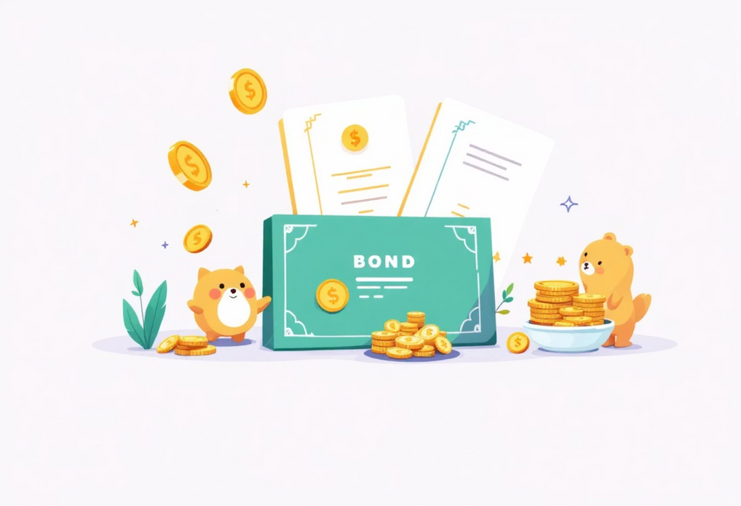
How Companies Raise Capital
IPO, FPO, and Bond Issuance Explained
IPO (Initial Public Offering)
Timeline: 6-month process from decision to listing. Company hires investment banks, conducts roadshows meeting 200+ investors globally, sets price with regulatory approval, opens for public subscription, and lists on exchange.
Example—Hyundai India IPO (2023): Price ₹1,900/share, 1.75 Crore shares issued, raised ₹3,300 Crore capital with 100x oversubscription. Day 1 return of +5%. Investment bank earned ₹45-50 Crore (1% underwriting fee).
1
FPO (Follow-On Public Offering)
When to use: Already-public company needs additional capital for expansion. Process is faster (30-45 days) with existing shareholders getting priority through rights issues.
2
Example—Reliance FPO: 2 Crore shares at ₹2,200 raised ₹44,000 Crore for refinery expansion and renewable energy. Existing shareholders experienced ownership dilution but company gained significant growth capital.
Bond Issuance (Debt Capital)
Structure: Company borrows ₹100 Crore for 5 years at 7% annual coupon, pays ₹7 Crore interest yearly, returns ₹100 Crore principal at maturity. Investors receive total ₹135 Crore (₹35 Cr interest + ₹100 Cr principal).
Advantages: No ownership dilution, interest is tax-deductible, fixed predictable cost. Risk: Must pay regardless of profitability—creates financial obligation in all scenarios.
3
Cost of Capital Concept: If a company finances 60% through debt at 8% (₹4.8 Cr cost) and 40% through equity at 12% (₹4.8 Cr cost), total cost of capital is 9.6%. The company must find projects earning above 9.6% to create value—this mechanism allocates capital to most productive uses.
Notes:
7

Slide 8



The Dark Side: Conflicts, Manipulation & Risk
1
2
3
Insider Trading
Market Manipulation
Systemic Failure
Trading on material non-public information. Example: CEO knows quarterly earnings will be ₹500 Cr (vs expected ₹400 Cr), buys 10,000 shares at ₹1,000 before announcement, sells at ₹1,250 after 25% jump—earning illegal ₹25 Lakh profit in one week.
Pump & Dump: Manipulator buys 10,000 shares at ₹10 (₹1 Lakh), posts fake news creating artificial demand, price jumps to ₹30, sells for ₹30 Lakh profit (₹29 Lakh gain)—retail investors lose 75% when truth emerges.
Lehman Brothers (2008): Major investment bank's bankruptcy on Sept 15, 2008 triggered global crisis. 300,000 customers couldn't access assets, banks stopped lending, stock markets crashed 50% globally, credit markets froze completely.
Spoofing: Placing fake large buy orders (50,000 shares), canceling 100 milliseconds later after algorithmic traders react, profiting from temporary price movement.
Cascade effects: AIG nearly collapsed, General Motors neared bankruptcy, global recession triggered, unemployment hit 10%+. Total wealth destroyed exceeded ₹50+ Lakh Crore.
SEBI Penalties: Up to ₹25 Cr fine, 25x profit disgorgement, 5-year imprisonment, permanent career destruction.
SEBI surveillance algorithms detect unusual patterns, repeated order cancellations, and trading spikes without news—resulting in ₹10 Cr+ fines and trading bans.
Real Case—Amit Goyal (JP Morgan, 2013): Traded on Bharti Airtel acquisition knowledge, made ₹70 Lakh, caught by SEBI pattern analysis, fined ₹1.5 Cr with 5-year ban.
India's 1992 Securities Scam: Harshad Mehta stole ₹450 Cr, market crashed 30% in 6 months, 23 convicted—led to dematerialization reforms eliminating fraud opportunities.
Broker Conflict
Rating Agency Conflict
Auditor Conflict
Earns ₹1,000 per trade but good advice says "trade less"—fiduciary duty vs commission incentive.
Paid by company being rated—temptation to rate favorably. Lehman bonds rated AA before 2008 collapse.
Wants long-term contract, creates temptation to go easy on client's accounting practices.
Circuit breakers protect Indian markets: 10% drop = 15-min halt, 20% drop = 1-hour halt, 40% drop = markets close for the day. These mechanisms prevent panic selling from cascading catastrophically.
Notes:
8

Slide 9
How This Knowledge Applies to Your Career
Practical Applications for Finance, Accounting & Tax Roles
Finance Professionals
Accounting & Audit
Tax & Compliance
Make informed investment decisions understanding that FII selling ≠ economic collapse—it's institutional reallocation. Evaluate cost of capital, predict market movements from policy changes, focus on institutional flows rather than retail sentiment.
Identify audit focus areas—capital adequacy for financial firms, loan loss provisions for banks, securities valuation for mutual funds. Detect conflict of interest risks, trace related-party transactions, assess disclosure adequacy for institutional ownership concentration.
Understand investment incentives—tax-exempt investors prefer dividends while high-income individuals prefer capital gains (20% vs 42% rate). Recognize that FII behavior changes with tax policy, optimize dividend policy based on shareholder tax status, structure transactions for tax efficiency.
Interview Ready: Explain how financial markets work, mutual fund operations, intermediary roles, and cost of capital calculations.
Interview Ready: Explain mutual fund financial statements, identify audit risks in financial markets, detect related-party fraud, understand why intermediaries are high-risk.
Interview Ready: Explain how taxation affects investor behavior, identify seasonal market patterns, analyze tax policy impacts on capital flows, describe tax-loss harvesting strategies.
The Common Thread: Financial markets are systems, not random events. Everything connects—tax policy drives investor behavior, which drives capital flows, affecting stock prices, company valuations, M&A decisions, audit focus areas, and regulatory scrutiny. Your competitive advantage comes from understanding these connections and using them to make better decisions and spot emerging risks before they materialize.
Notes:
9

Slide 10
Key Takeaways
Ecosystem Understanding
Institutional Dominance
Financial markets connect savers with entrepreneurs through investors, companies, intermediaries, regulators, and supporting ecosystem participants—each playing irreplaceable roles.
Institutional investors control 70% of market volume with ₹45+ Lakh Crore AUM—understanding their behavior is essential for predicting market movements.
Technology Revolution
Risk Awareness
Transaction costs dropped 98% since the 1990s—from ₹1,750 to ₹35 per trade—democratizing market access for millions of retail participants.
Insider trading, market manipulation, and systemic failures remain persistent threats—regulation is reactive, catching fraudsters after damage occurs.
Career Applications
Systems Thinking
This knowledge directly applies to finance, accounting, and tax roles—providing competitive advantage in interviews and day-to-day professional decision-making.
Markets operate as interconnected systems where policy, behavior, flows, prices, and valuations create cascading effects—understanding these connections separates good professionals from great ones.
Financial markets represent humanity's solution to the fundamental challenge of efficiently allocating capital. As finance professionals, your role is to understand these complex systems, identify emerging patterns, manage inherent risks, and make decisions that create value while protecting stakeholders. This foundation prepares you to navigate the sophisticated world of corporate finance and capital markets with confidence and expertise.
Notes:
10

